Slide 1

Mini Capstone Project
Crime data Analysis
Submitted by:
Anju
# S8044

Slide 2
Objectives
Database Setup and Import
Create a MySQL database
Load the provided crime dataset into the MySQL database.
Database connection
Use PyMySQL to establish a connection to the database in Pycharm.
Verify the successful import of data in pycharm.
Data Exploration
Retrieve basic statistics on the dataset, such as the total number of records and unique values in specific columns.
Identify the distinct crime codes and their descriptions.
Temporal Analysis
Analyze the temporal aspects of the data.
Spatial Analysis
Utilize the geographical information (Latitude and Longitude) to perform spatial analysis
Crime code Analysis
Victim Demographics
Investigate the distribution of victim ages and genders
Identify common premises descriptions where crimes occur
Status Analysis
Examine the status of reported crimes
Classify crimes based on their current status

Slide 3
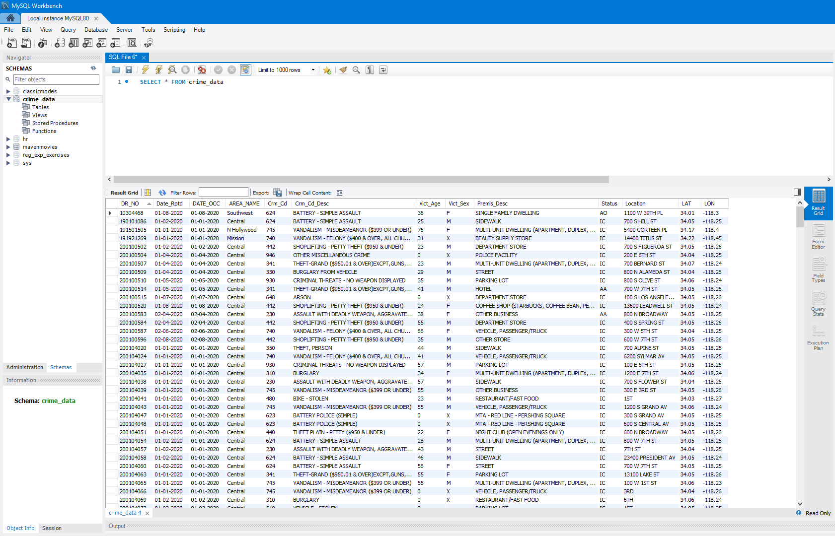
1) Database setup and import

Slide 4
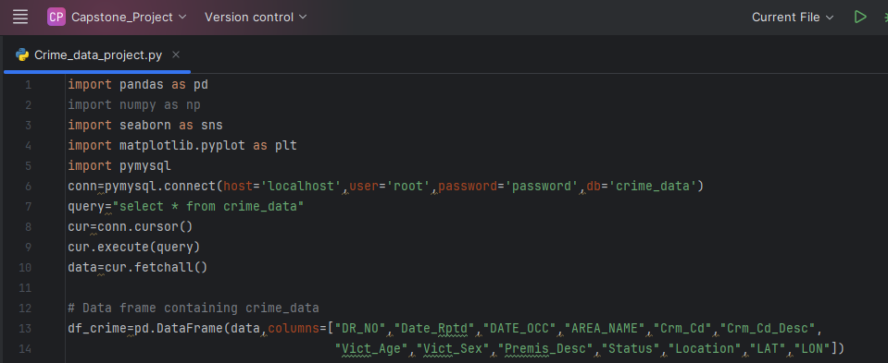
2) Database connection

Slide 5
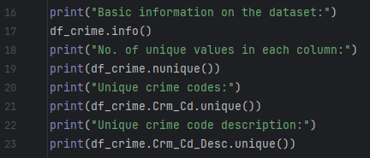
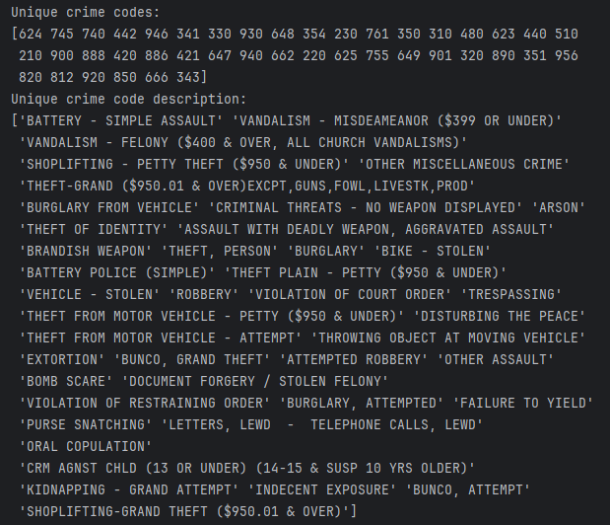
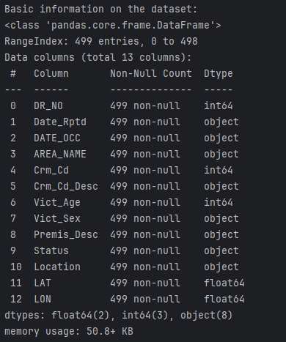
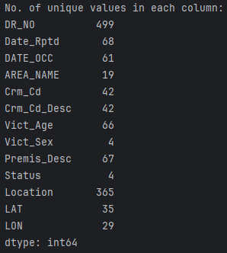
3) Database exploration

Slide 6
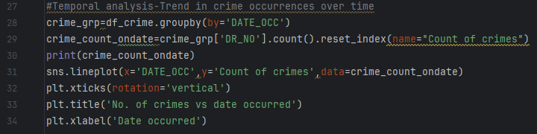
4) Temporal Analysis - No. of crimes vs Date occurred

Slide 7
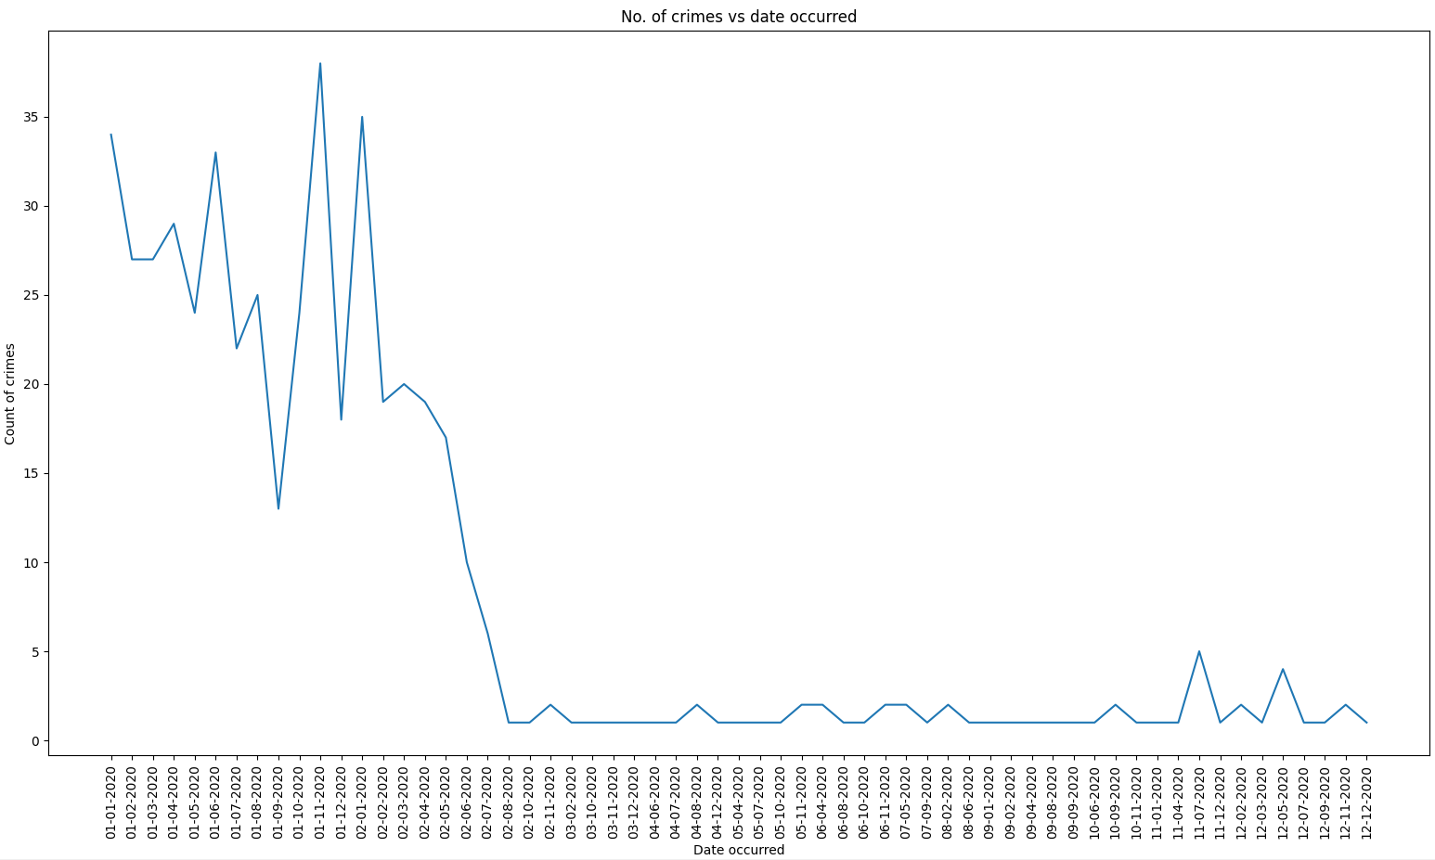
4) Temporal Analysis (cont.)

Slide 8
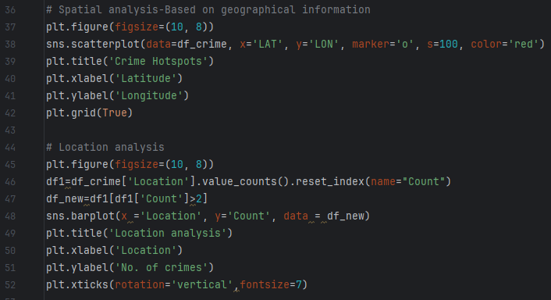
5) Spatial Analysis – Crime Hotspots

Slide 9
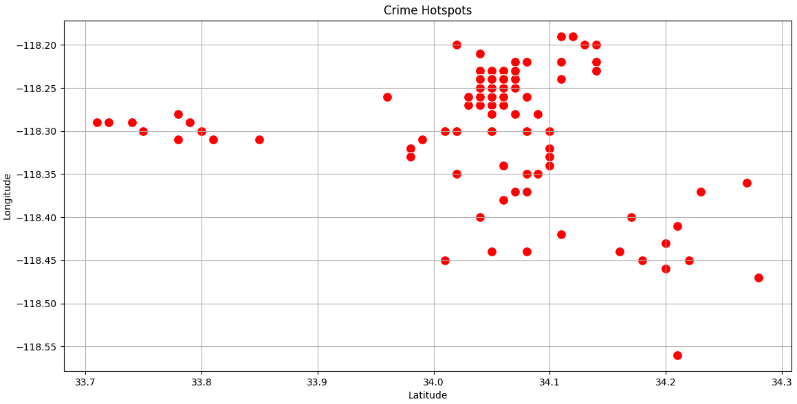
5a) Spatial Analysis (cont.)

Slide 10
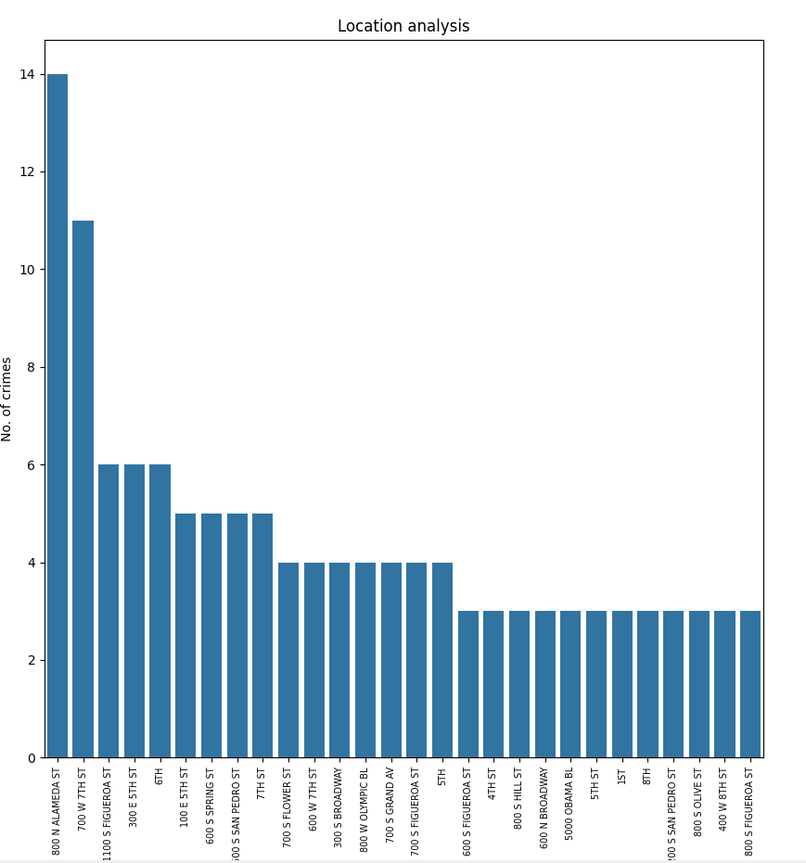
5b) Spatial Analysis (cont.)

Slide 11
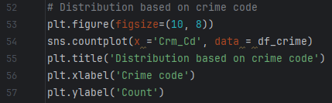
6) Crime code Analysis

Slide 12
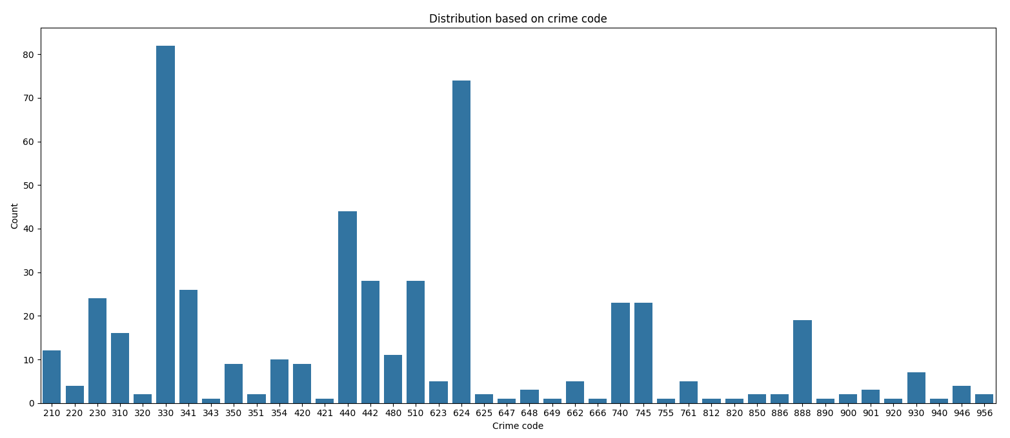
6) Crime code Analysis (cont.)

Slide 13
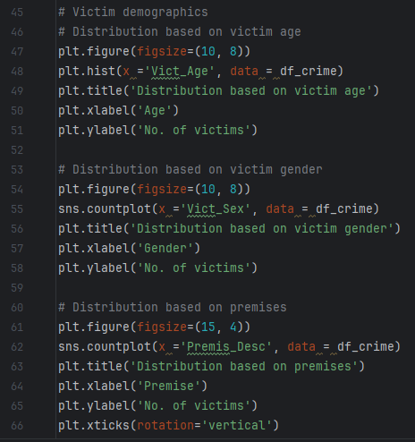
7) Victim Demographics – based on victim ages, gender and crime premises

Slide 14
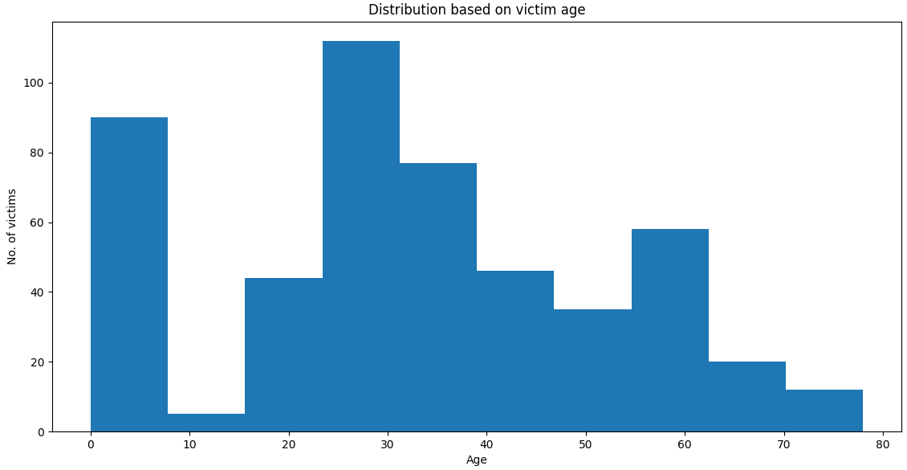
7a) Histogram based on victim ages

Slide 15
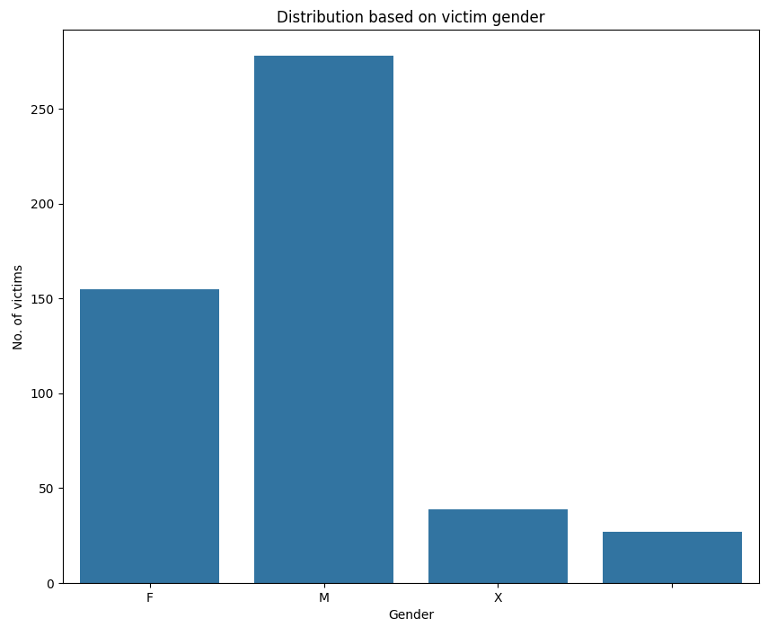
7b) Countplot based on victim gender

Slide 16
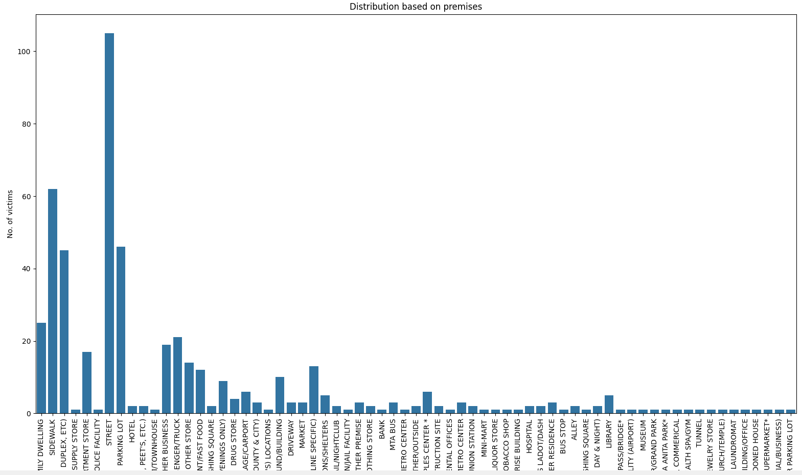
7c) Common premises where crimes occurred

Slide 17
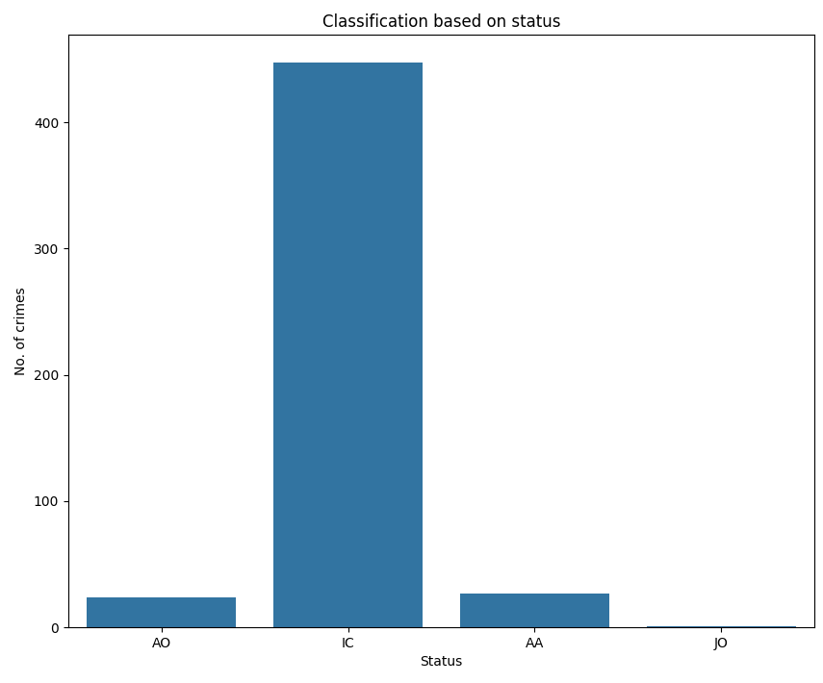
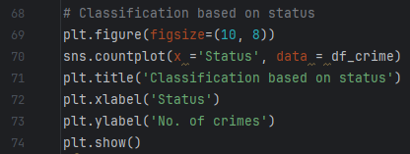
8) Status Analysis

Slide 18
Analysis insights
Based on temporal analysis, the crime count shows a decreasing trend. The peak crime count was on 11-1-2020. The crime count had a sharp decrease from 3-2-2020 to 8-2-2020, after which it remains fairly constant.
Based on spatial analysis, the crime hotspot is around latitude=34.05 and longitude= -118.25. Highest no. of crimes (14 no.s) were recorded at 800 N Alameda St.
Based on crime code analysis, crime ‘330- Burglary from vehicle’ was the highest recorded crime followed by ‘624-Battery-Simple Assault’.
Highest no. of crimes were against victims of age 24 to 30. Lowest were against victims of ages 8 to 17.
There is a significant difference in crime rates against male and female victims. The crimes against males were about double that against female victims.
Street premises were recorded to have the highest no. of crimes followed by sidewalk.
Crimes with status of IC were highest. Crimes with status AO and AA had about the same count and were negligible compared to crimes with IC status.

Slide 19
Thank You

